Slide 1
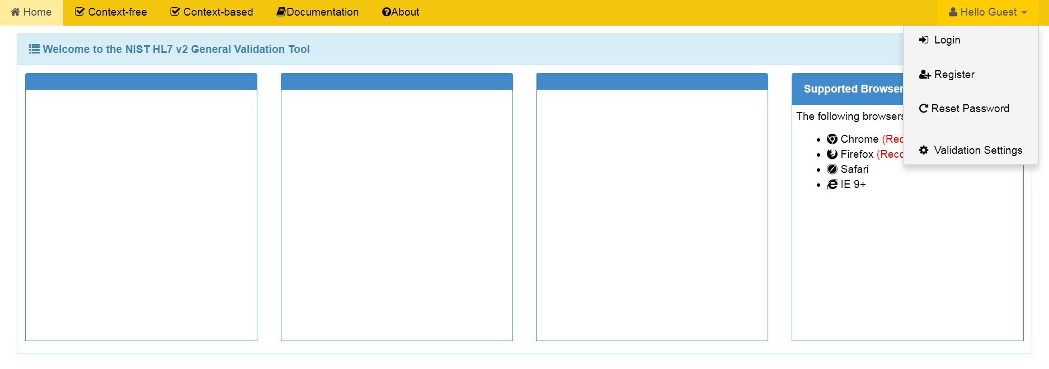
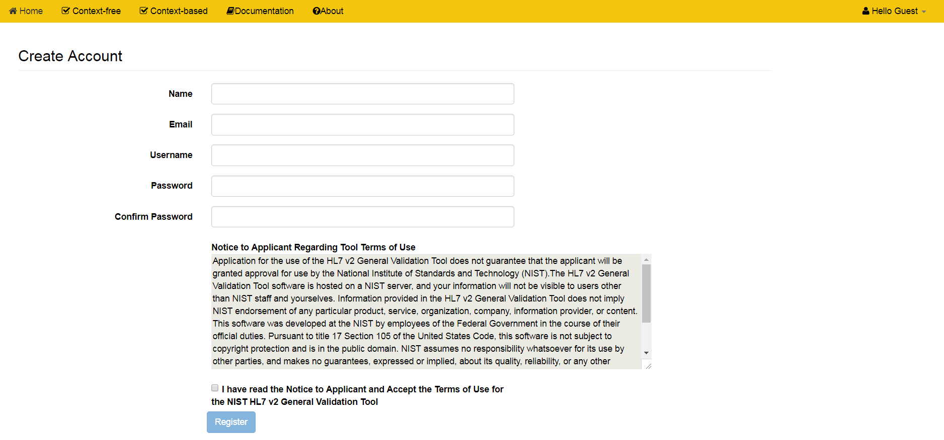
GVT Registration
1
Click on Hello Guest to display the dropdown menu.
2
Click on the Register option.
3
Enter the requested information into the provided fields.
4
Read the Notice to Applicant.
5
Check the box to indicate you accept the Terms of Use.
You will be notified by email when your account is activated.
6
Click the Register button.

